Slide 1

MAZE RUNNER​
Minimum Viable Product Edition
Notes:
https://github.com/scouter238/Maze_Runner

Slide 2
Quick Introduction
Group: Maze Runner
Name: Cameron Dearien
Role: Software Architect

Slide 3
GIT &
Unity Project Creation
Notes:
https://github.com/scouter238/Maze_Runner

Slide 4
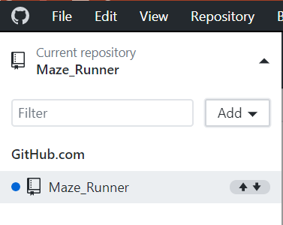
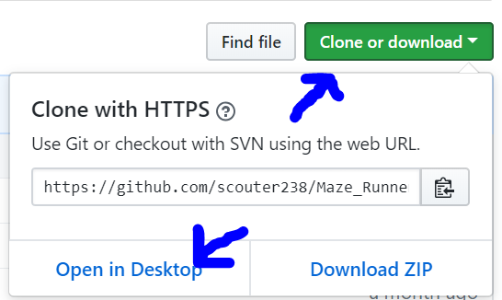
Github
Desktop version
Website version
Notes:
https://github.com/scouter238/Maze_Runner

Slide 5
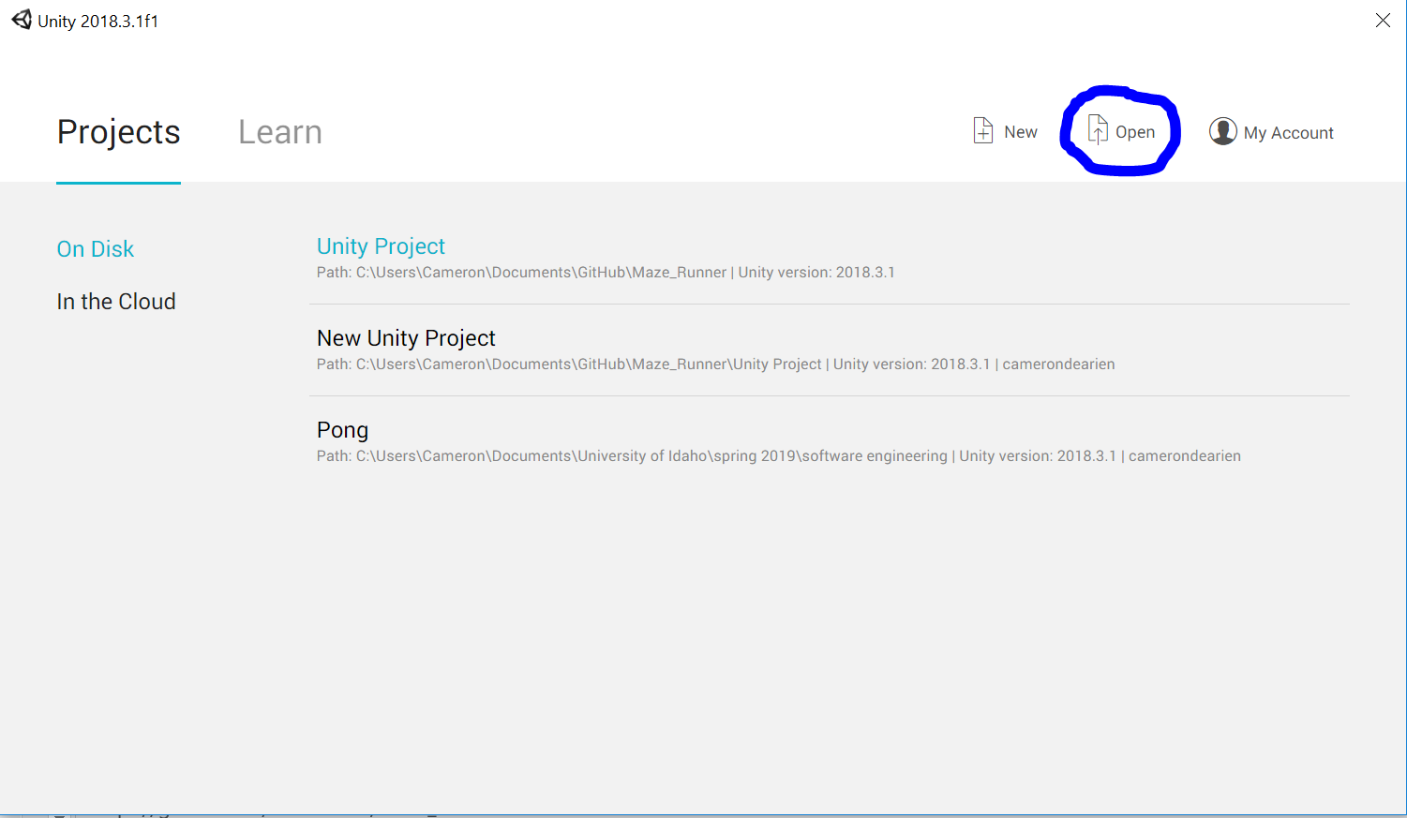
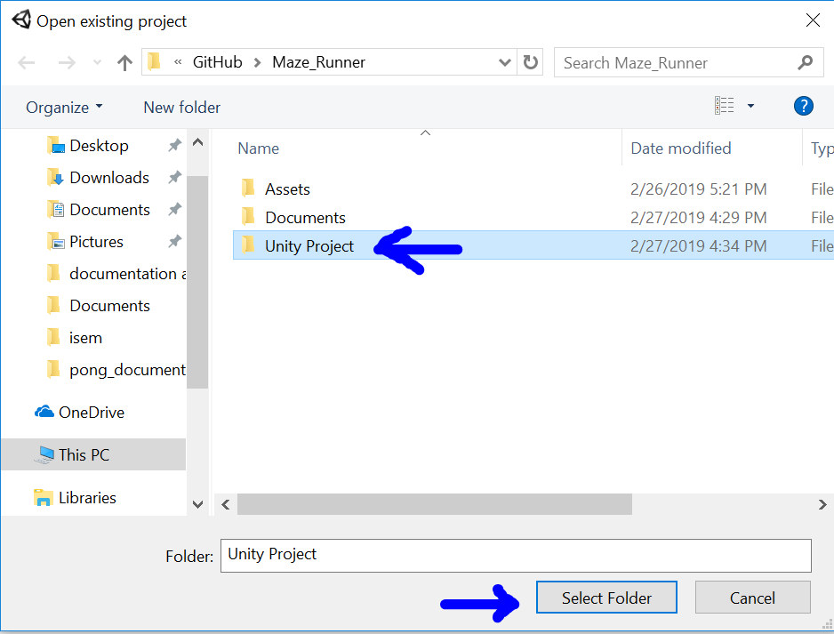
Unity
Open Button
Finding the project
Notes:
https://github.com/scouter238/Maze_Runner

Slide 6
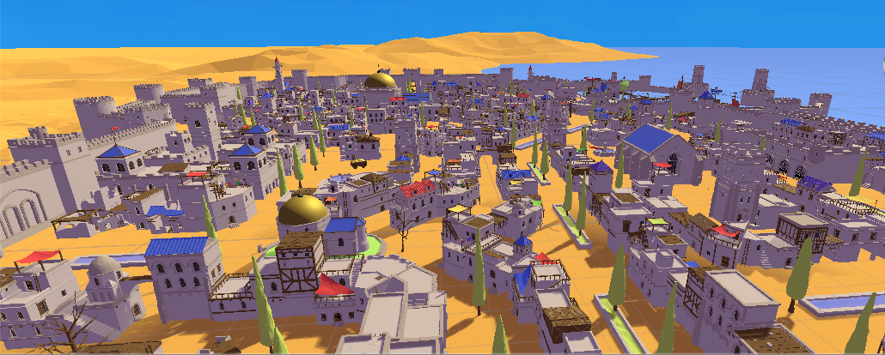
Map
Notes:
https://github.com/scouter238/Maze_Runner

Slide 7
Enemy and Player Movement
Pardon the brief interruption as I play two videos from my computer and not powerpoint
https://www.youtube.com/watch?v=R8srk9E9FCA&feature=youtu.be
Somewhere on my computer
Notes:
https://github.com/scouter238/Maze_Runner

Slide 8
Show team progress with code snapshots
Enemies & movement
Notes:
https://github.com/scouter238/Maze_Runner

Slide 9
Questions?
Notes:
https://github.com/scouter238/Maze_Runner

